Slide 1

QuickFin
By - Nitant Jatale
QuickFin is an innovative chatbot that leverages Retrieval-Augmented Generation (RAG) to answer queries about financial documents like 10Q and 10K reports. By combining advanced document retrieval with generative AI capabilities, QuickFin aims to revolutionize how users extract and understand key information from lengthy financial reports.

Slide 2

Introduction
1
Brief Overview
Develop a chatbot that leverages Retrieval-Augmented Generation (RAG) to summarize financial documents like 10Q and 10K reports. The chatbot retrieves relevant information from these documents and generates accurate answers based on user queries.
2
Objectives and Goals
- To assist users in quickly extracting and understanding key information from lengthy financial documents. - To combine document retrieval with generative capabilities to provide concise and relevant answers.
3
Importance and Relevance
Financial documents are complex and time-consuming to read. This tool will assist investors, analysts, and in general any user in making informed decisions.

Slide 3

Project Description
Detailed Description
The chatbot will read PDFs of financial reports, chunk the text for efficient processing, and use RAG to combine document retrieval with generative capabilities of language models to provide concise summaries and answers.
Specific Problem
Users need to manually read through extensive financial reports to find relevant information, which is time-consuming and inefficient. GPT-4 gives different results when asked the same question multiple times, showing hallucinations. This behavior is not observed in our RAG based System.
Scope
Includes data ingestion and processing, RAG implementation, and development of a user-friendly chatbot interface.

Slide 4
Differentiation from GPT
When comparing our RAG (Retrieval-Augmented Generation) system to GPT-4, some key differences emerge that highlight the advantages of our approach. While GPT-4 is a powerful language model, it faces certain challenges that our RAG system effectively addresses.
GPT-4 Challenges
Our RAG System Advantages
Inconsistency in responses
Consistent answers
Limited context handling
Efficient document handling
Lack of retrieval mechanism
Focused summarization
GPT-4 may produce different results when asked the same question multiple times, indicating hallucinations. It also struggles with very long documents and may miss relevant details. Additionally, GPT-4 does not have an inherent retrieval mechanism to fetch specific document parts before generating answers.
By using a retrieval mechanism, the RAG system consistently provides accurate and relevant responses. The system processes and retrieves specific chunks from long documents, ensuring all relevant information is considered. It combines document retrieval with generative capabilities, ensuring the generated summaries are contextually accurate and complete.

Slide 5
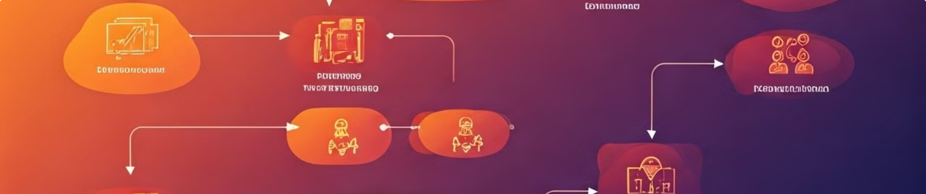
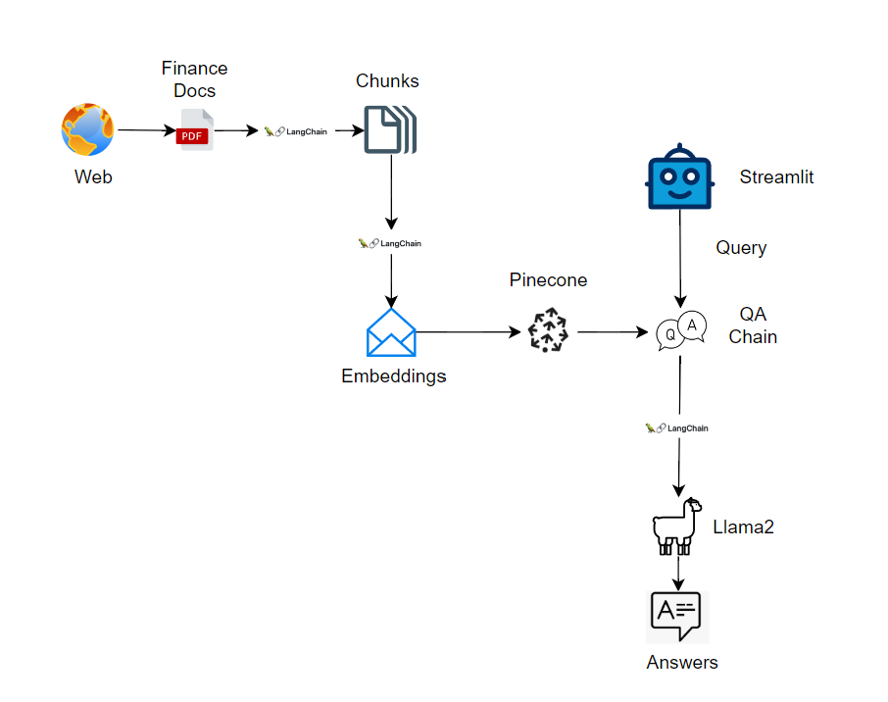
Project Architecture

Slide 6
Project Architecture
1
Data Ingestion
Financial PDFs are ingested.
2
Text Splitting
Documents are split into chunks for efficient processing using LangChain.
3
Embeddings
Text chunks are converted into embeddings.
4
Vector Store
Embeddings are stored in Pinecone for efficient retrieval.
5
Query Handling
User queries are processed by the chatbot, which uses a QA chain to retrieve relevant chunks from Pinecone.
6
Response Generation
LLama 2 model generates concise and accurate answers based on the retrieved chunks and the prompt template for financial RAG.

Slide 7
Data Collection and Preprocessing
Source and Nature
Steps
Techniques
Financial reports (10Q, 10K) available online.
Reading PDFs
Text cleaning, tokenization, and indexing.
Chunking text
Preprocessing for efficient retrieval and generation

Slide 8




RAG Pipeline Implementation
Overview
Combining document retrieval with language model generation to provide accurate and concise answers.
Steps
1. Retrieve financial reports using online sources. 2. Process and chunk the text for efficient retrieval. 3. Implement RAG to generate summaries based on user queries. 4. Integrate with a chatbot for user interaction.
Challenges
Ensuring accuracy and relevance of generated summaries, handling large documents.

Slide 9

Performance Metrics
Key Metrics
Description
Faithfulness
Factual consistency of the generated answers against the given context if all claims that are in answers can be validated from given context.
Score the relevancy of answers according to a given question. Redundant answers
are penalized.
Answer Relevancy
Context Recall and Precision
Extent to which the retrieved context aligns with the ground truth.
Methods: User feedback, comparison with financial benchmarks, usage analytics.
Initial Results: Preliminary evaluations on model performance using different model like Llama, GPT4 etc...
Note: GPT-4 gives different results when asked the same question multiple times, showing hallucinations. This behavior is not observed in our RAG system.

Slide 10




Methods to Improve Metrics
Strategies
Enhance text chunking, fine-tune language models, incorporate user feedback.
Changes Planned
Refine preprocessing steps, improve model training, integrate advanced retrieval techniques.
Impact
Improved accuracy and relevance of generated summaries.

Slide 11
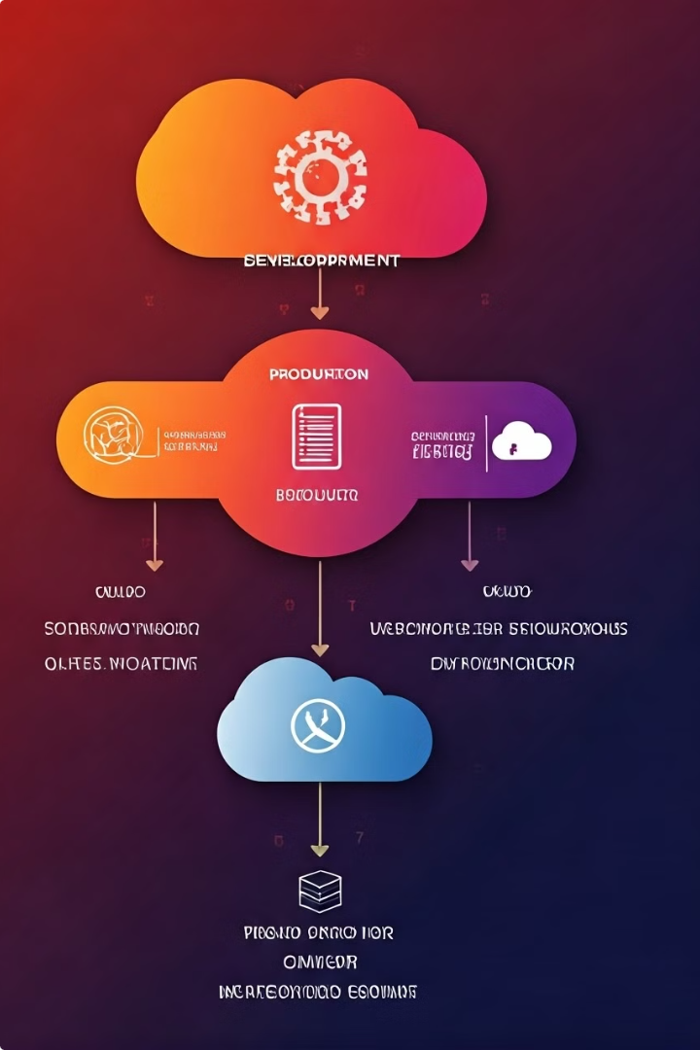
Deployment Plan
1
Steps
System testing, deployment on cloud platforms, continuous monitoring and updates.
2
Tools
Python, Pinecone, Streamlit, Azure.
3
User Testing
Beta testing with classmates to gather feedback and improve the system.

Slide 12

Future Work
1
Extensions
Support for additional financial documents, more sophisticated analysis features.
2
Vision
To become a comprehensive tool for financial document analysis and summarization.
3
Development Beyond Course
Ongoing improvements based on user feedback and evolving technologies.

Slide 13

Conclusion and Q&A
Summary
Q&A Preparation
A chatbot that provides concise summaries of financial documents to assist users in making informed decisions.
Ready to discuss data sources, RAG implementation, and future enhancements.
Key Takeaways
Importance of efficient document processing and accurate information retrieval.
Final Thoughts
Potential to revolutionize how financial information is accessed and understood.

